Slide 1
Spark Architecture at a glance
Noam Cohen
2023-02-04
Based on "Spark the Definitive Guide" book

Slide 2
Components of a Spark deployment
Cluster manager -- decides where a job will be executed
Driver – the entry point of a Spark application
Executor – one or more in each worker
In the next slides we shall see the interaction between these components.

Slide 3
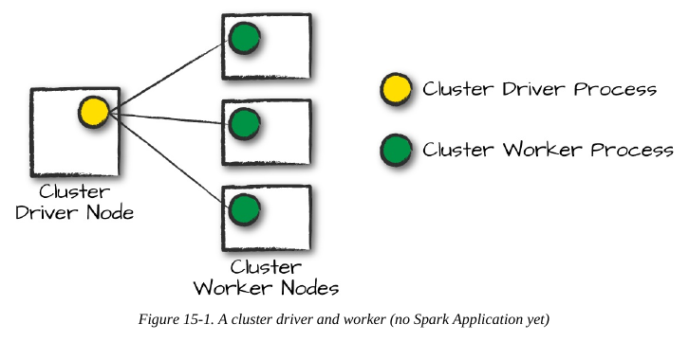
The Cluster manager decides where a job will be executed

Slide 4
Execution modes
Cluster mode
Client mode -- nearly the same as cluster mode except that the Spark driver remains on the client machine that submitted the application
Local mode – everything in one machine. For testing only.

Slide 5
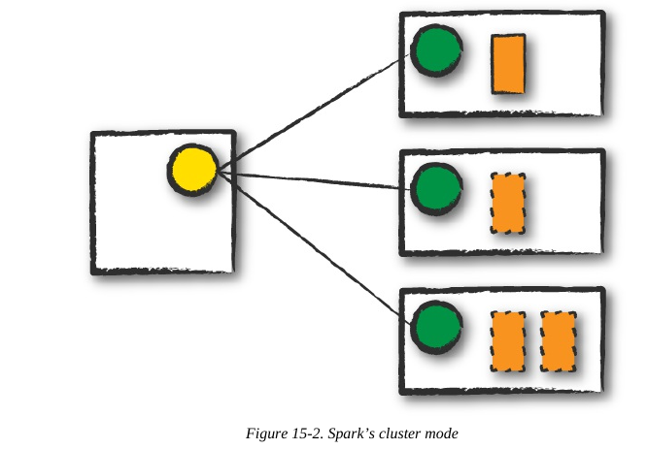
Cluster mode
Spark Driver process
Spark Executor process
The cluster manager then launches the driver process on a worker node inside the cluster, in addition to the executor processes.

Slide 6
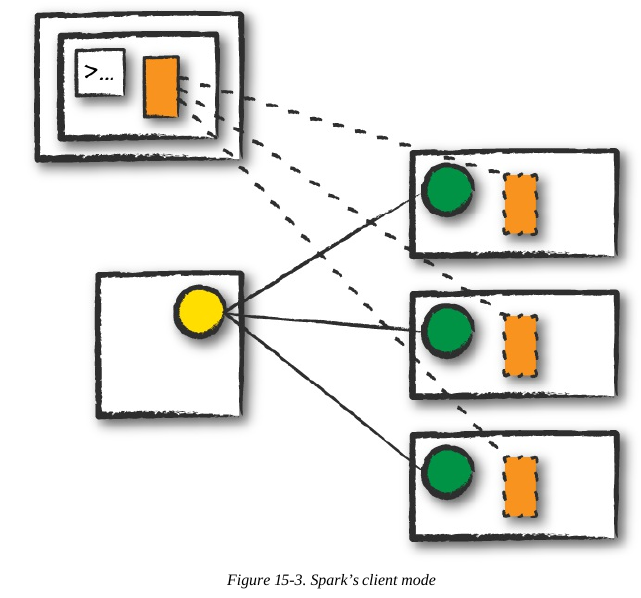
Client mode

Slide 7
The Life Cycle of a Spark Application (Outside Spark)
ask the cluster manager (CM) to start driver on one of the nodes.
the driver asks the CM to start executor processes on the worker nodes.
Now the "spark cluster" is ready to accept work.
describe JAR (java/scala) vs. python

Slide 8
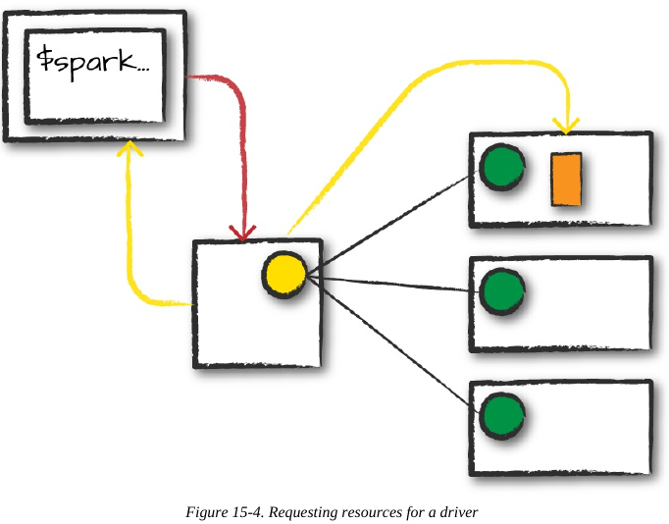
Client request
First, ask the CM for resources for the Spark driver process

Slide 9
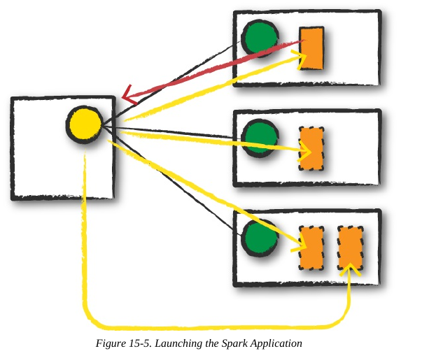
Launch my code
Spark Driver process
Spark Executor process

Slide 10
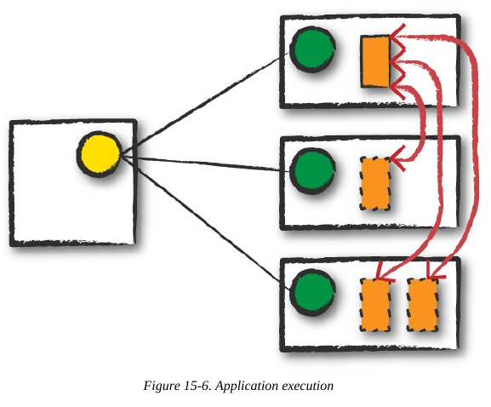
Execution
The driver and the workers communicate among themselves, executing code and
moving data around. The driver schedules tasks onto each worker, and each worker responds
with the status of those tasks and success or failure.

Slide 11
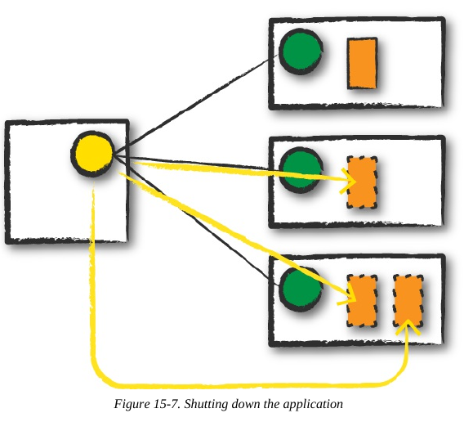
Completion
After a Spark Application completes, the driver process exits with either success or failure.
The cluster manager then shuts down the executors in that Spark cluster for the
Driver.
At this point, you can see the success or failure of the Spark Application by asking the cluster manager for this information.

Slide 12
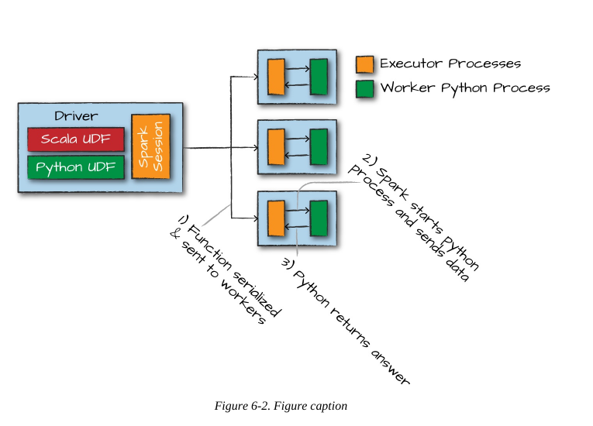
When using python...

Slide 13
The Life Cycle of a Spark Application (Inside Spark)
We just examined the life cycle of a Spark Application outside of user code (basically the infrastructure that supports Spark), but it’s arguably more important to talk about what happens
within Spark when you run an application. This is “user-code” (the actual code that you write
that defines your Spark Application)

